Slide 1
491 Team 1: Interactive Secure Headset
Rob Barton, Asa Pauls, Morgan Ambourn, Nathan Andersen, Ehren Fox, Zach Johnson
Notes:
Zach
Introduce the project
A VR-type headset that allows users to take various types of tests (standardized, professional certifications, etc.)
Headset is intended to prevent cheating and theft of test question data
Introduce general technical challenges
We need to display data to a user in a readable way
We need to make sure the user is comfortable
We need to make sure the user is safe
Transition into Ehrens slide, mention that the rest of the team will explain the challenges we face in more depth

Slide 2
Displaying the test to users
The issues
We need to get data to a user
Needs to be legible
Enough room for a small paragraph
Don’t have a lot of room
Notes:
ehren

Slide 3
Addressing the display
How many screens?
How big?
How transparent?
How to decide?
Notes:
Nathan Andersen

Slide 4
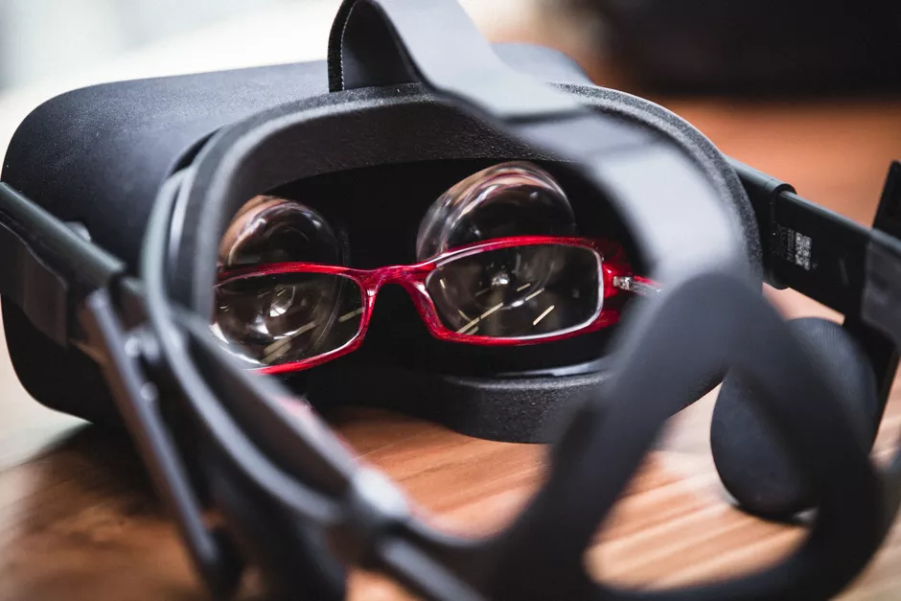
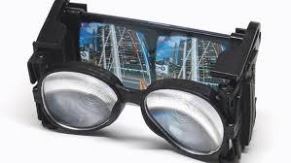
Optics
Space issue
User glasses
Lenses, optics
Looking to experts
Notes:
Morgan
There is minimal space within the headset cavity as we want to keep the weight and size of the headset to a minimum for the comfort of the user. Ensure room for glasses within the headset. We want to accommodate glasses, but also ensure security. Glasses introduce a security risk as they could have a camera attached to the glasses frame. In addition to fitting glasses, we will need to implement lenses between the screen and the user’s eyes to ensure the eyes can focus on such a close screen. Lenses and optics are topics outside of our team’s expertise. For this reason, we are looking to experts within the field of optics for guidance.

Slide 5
Tying it all together
Close to VR
Notable differences
Working within a greater system
Hardware
Software
Future updates
Notes:
Rob

